Slide 1
Lecture 03 - Morphology
Prof. André Gustavo Hochuli
gustavo.hochuli@pucpr.br
aghochuli@ppgia.pucpr.br
Notes:
Prof. André Hochuli

Slide 2
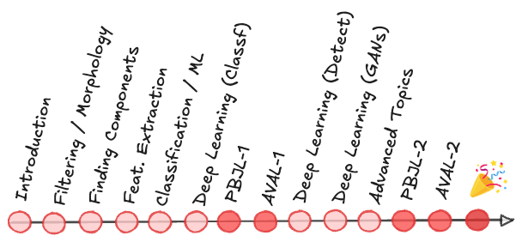
Topics
Discussion of Practice 02
Image Binarization
Mathematical Morphology
Structuring Element (or Kernel)
Erode /Dilate
Open / Close
Gradients
Watershed
Practice
Computer Vision - Prof. André Hochuli
Lecture 03
Notes:
Prof. André Hochuli

Slide 3
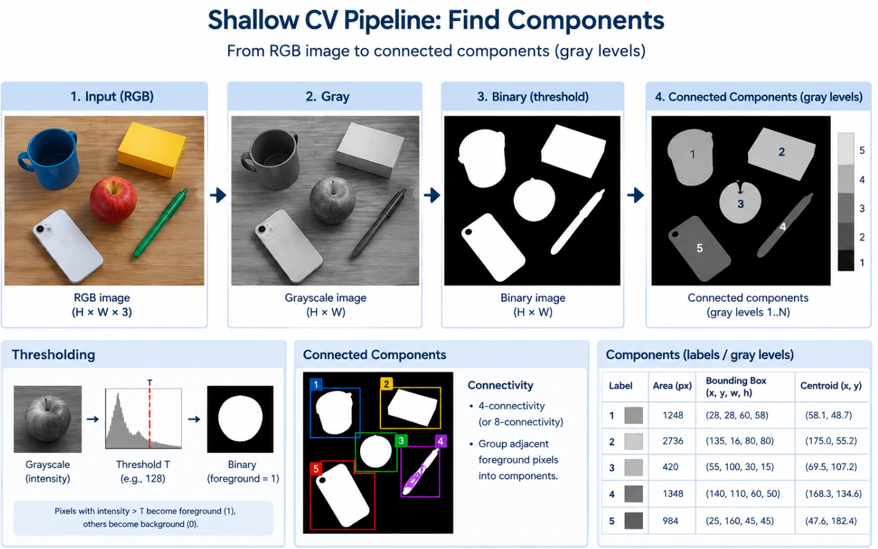
Image Binarization
Computer Vision - Prof. André Hochuli
Lecture 03

Slide 4
Image Binarization
Why Binarize the Image?
Separate foreground from background
Converts the image into two classes: object (1) and background (0).
Simplify the image representation
RGB: H×W×3
Gray: H×W, many intensity values
Binary: H×W, only 0 or 1
Enable object/component analysis
Connected-component algorithms operate on foreground pixels and group spatially connected pixels into individual objects.
Reduce irrelevant information
Once segmentation is defined, exact color/intensity values are no longer necessary for identifying components.
Computer Vision - Prof. André Hochuli
Lecture 03

Slide 5
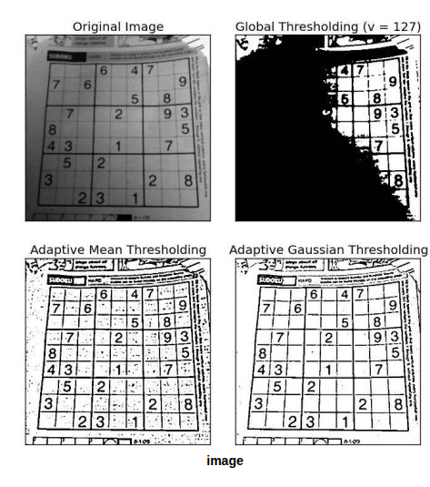

Image Binarization – Threshold Selection
Defining the threshold value T is a key step
B(x,y)={1,0,​I(x,y)≥TI(x,y)<T​
Threshold selection is critical (20, 50, 127, 250?)
Too low → background and noise become foreground
Too high → object pixels and details are lost
Appropriate T → good foreground–background separation
Common approaches
Global Thresholding: a single T for the entire image
Otsu's Method: automatically estimates an optimal global T
Adaptive Thresholding: T varies according to local image regions
Computer Vision - Prof. André Hochuli
Lecture 03

Slide 6
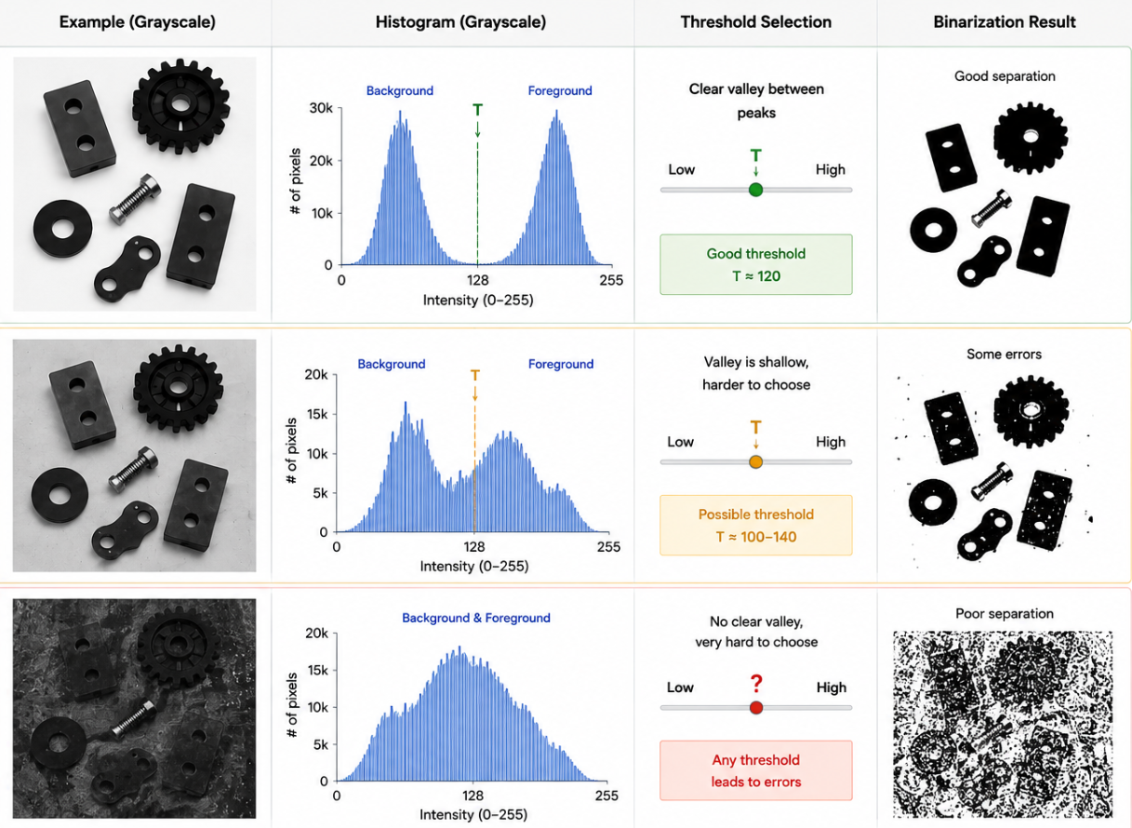
Image Binarization – Threshold Selection
Defining the threshold value T is a key step
Image Histogram
Represents the distribution of pixel intensities in an image.
Y-axis: number (or frequency) of pixels at each intensity.
Provides a global description of image appearance:
Brightness
Contrast
Intensity distribution
Useful for binarization
Peaks may represent different image regions/classes.
A threshold T can be selected near the valley between the peaks.
Computer Vision - Prof. André Hochuli
Lecture 03

Slide 7
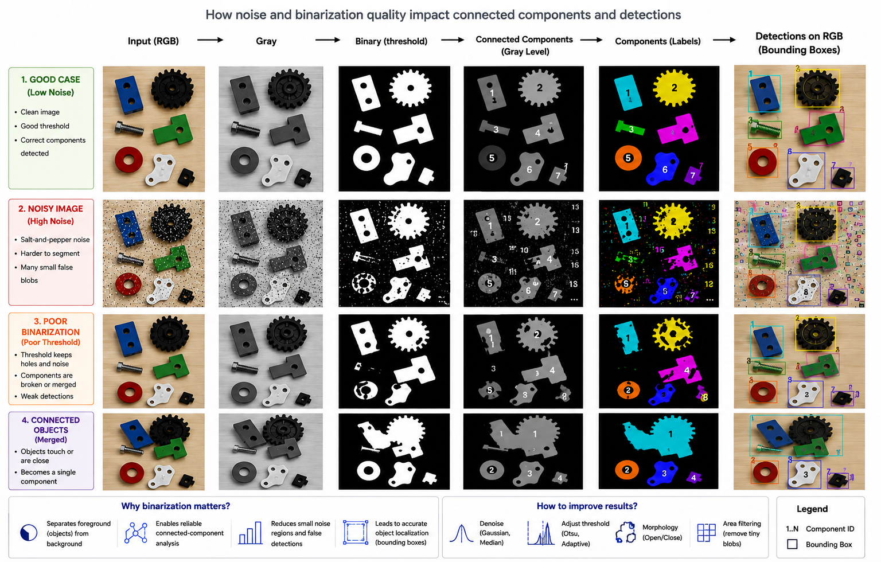
Image Binarization
Computer Vision - Prof. André Hochuli
Lecture 03

Slide 8
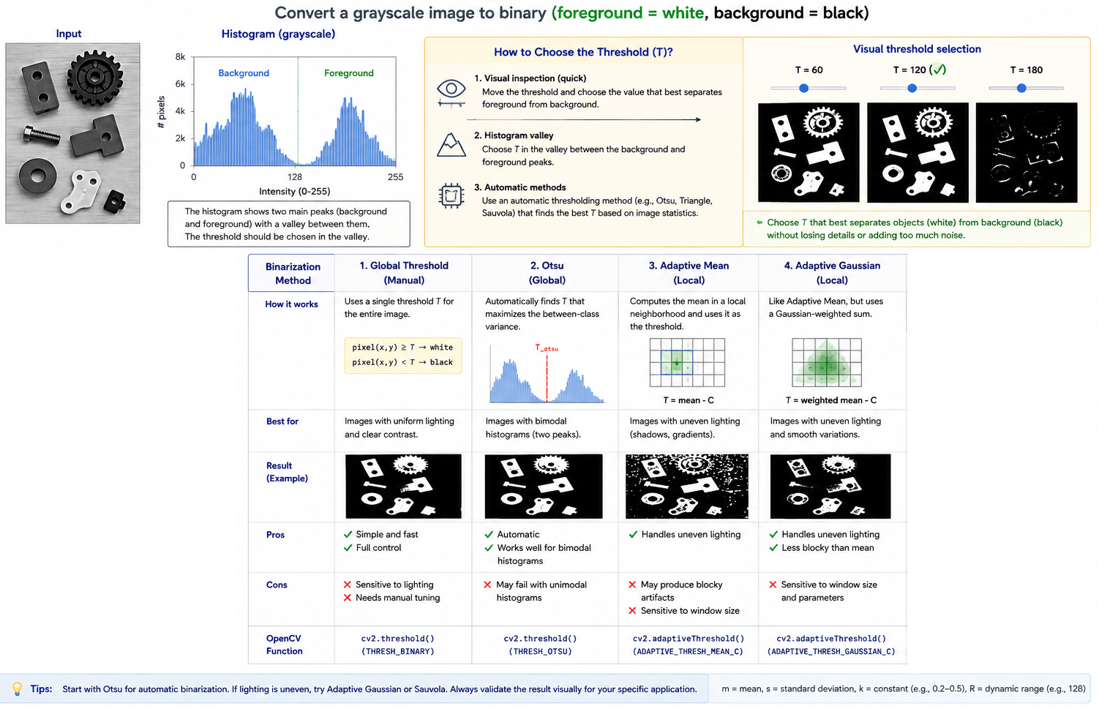
Image Binarization
Computer Vision - Prof. André Hochuli
Lecture 03

Slide 9
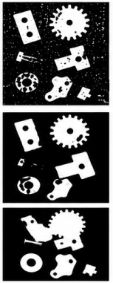
Image Binarization
What If Binarization Produces Noisy or Fragmented Objects?
Computer Vision - Prof. André Hochuli
Lecture 03

Slide 10
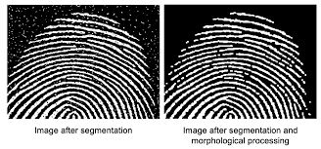
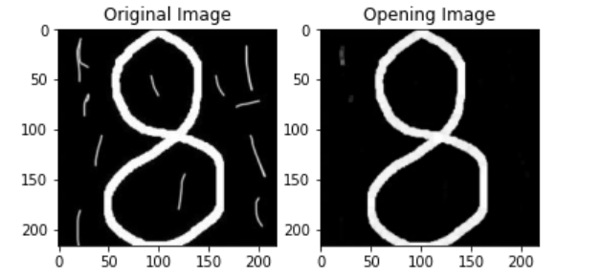


Mathematical Morphology
Morphology (Nature): Branch of Biology that study the form and structure of animals and plants
Morphology (Image Processing): Mathematical operations to extract image components based on pixel neighborhood.
Increase/Decrease Objects Size, Reduce Noise, Closing or Open
Computer Vision - Prof. André Hochuli
Lecture 03
Lecture 03
Notes:
Prof. André Hochuli

Slide 11
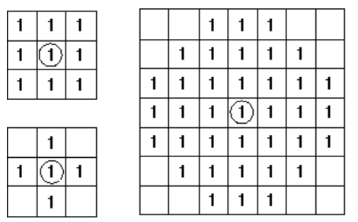
Structuring Element (Kernel)
Defines the shape of the structure to be applied
The structure is slid through the image
Erosion or Dilate operations are applied
The origin determines the pixel be changed
Computer Vision - Prof. André Hochuli
Lecture 03
Notes:
Prof. André Hochuli

Slide 12
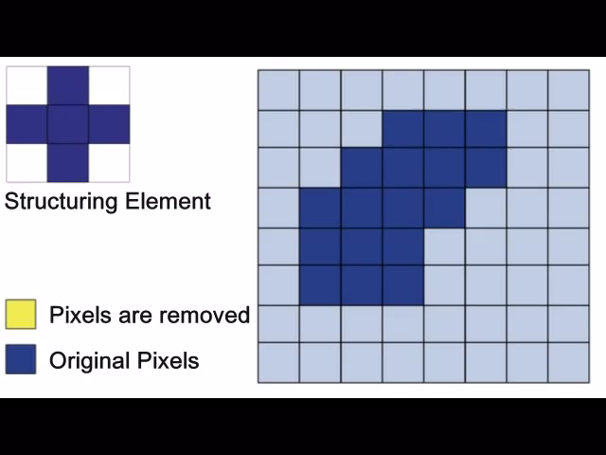
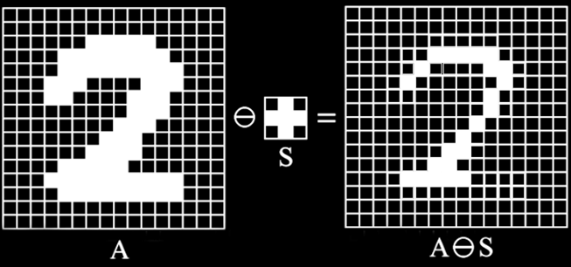
Erosion
Moves one’s to zero’s
Binary ‘AND’ Operation
Reduces Noises and Contours
https://www.youtube.com/watch?v=fmyE7DiaIYQ
Computer Vision - Prof. André Hochuli
Lecture 03
Notes:
Prof. André Hochuli

Slide 13
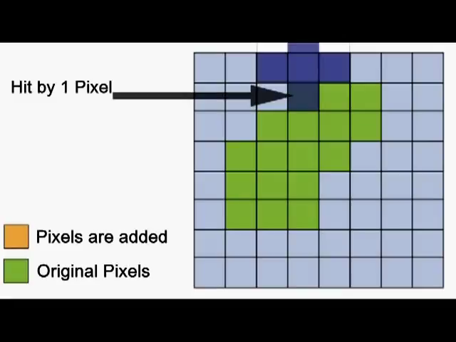
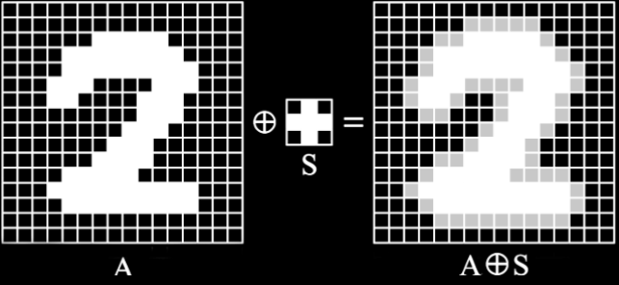
Dilation
Moves zero’s to one’s
Binary ‘OR’ Operation
Increases Objects, connects contours, and fill holes.
https://www.youtube.com/watch?v=xO3ED27rMHs
Computer Vision - Prof. André Hochuli
Lecture 03
Notes:
Prof. André Hochuli

Slide 14


Opening and Closing
Combined morphological operations that preserve the shape and size o large objects in the image
Opening: Erode + Dilate
Removes small objects, noises, and thin lines
Closing: Dilate + Erode
Fill small holes and connect segmented contours
Computer Vision - Prof. André Hochuli
Lecture 03
Notes:
Prof. André Hochuli

Slide 15


Others Morphological Operations
Gradient: Dilate - Erosion
Outline de Object
TopHat: Open – Original Image
Reduce the effect of brightness changes
Isolates brightness objects
Computer Vision - Prof. André Hochuli
Lecture 03
Notes:
Prof. André Hochuli

Slide 16
Let’s code!
Link: Morphology Operators
Computer Vision - Prof. André Hochuli
Lecture 03
Notes:
Prof. André Hochuli

